Slide 1
Section 3.6: An Introduction to Cryptography
Math for Liberal Studies

Slide 2
Adding Security to Messages
How do we protect the security of the messages we send?
This is a very important issue in the information age
Consider the number of times you send information you hope is secure:
text messaging
e-mail
online shopping
etc.

Slide 3
Prevention: Not an Option
It is largely impossible to prevent messages from being intercepted
Since we can’t keep people from reading our messages, we should try to disguise them so that the messages only make sense to the intended recipient
This process is called “encryption”

Slide 4
Encryption: Systems are Key
Whenever we encrypt a message, it is vital that we do it systematically
Both you and the person you want to send the message to agree on a secret system
Many systems are based on a keyword or phrase that is only known to a select few

Slide 5
Ciphers and Cryptography
Cryptography is the study of processes by which information is disguised so that unintended recipients cannot understand it
A cipher is a reversible rule for disguising a message
There are many different ciphers, and we will learn about a few in this section

Slide 6
Encryption and Decryption
Encryption is the process of disguising the message
Decryption is the reverse process
We want ciphers that are simple enough to use regularly, but complex enough so that the messages cannot be easily decrypted by someone who does not know the rule

Slide 7
Reversibility
It is vital that the cipher be a reversible rule, otherwise the message cannot be undisguised
There is no point in encrypting a message if no one can ever recover the original message

Slide 8
The Caesar Cipher
One of the simplest ciphers is called the Caesar cipher
This method is named after Julius Caesar (100 – 44 BCE) who used it to communicate with his generals

Slide 9
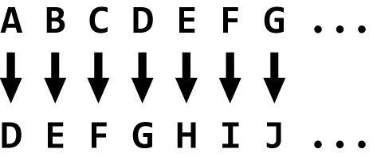
The Caesar Cipher
Take the letters of your message and change them according to this rule:
Each letter is replaced by the letter that is three places later in the alphabet

Slide 10
The Caesar Cipher
What happens when we get to the end of the alphabet?

Slide 11
The Caesar Cipher
What happens when we get to the end of the alphabet?
We simply wrap around back to the beginning

Slide 12
An Example
Let’s encode the message “Attack at daybreak”

Slide 13
An Example
We will typically omit spaces and other punctuation when we encode messages
Knowing the lengths of the words in our message could give the enemy a clue to the contents of our message

Slide 14
An Example
However, to make the message more readable, we will often split the message into “blocks” of equal length
This time we’ll use blocks of length 4
Our encoded message becomes “DWWD FNDW GDBE UHDN”

Slide 15
An Example
Our encoded message becomes “DWWD FNDW GDBE UHDN”
To decode the message, we simply go backwards 3 steps in the alphabet
We may have to wrap around back to the end of the alphabet

Slide 16
Another Example
This message was encoded using the Caesar cipher: “DOOZR UNDQG QRSOD BPDNH VMDFN DGXOO ERB”

Slide 17
Substitution Ciphers
The Caesar cipher is an example of a substitution cipher
Each letter of the message is replaced by another letter according to a consistent rule
The cryptoquote puzzle in the newspaper is another example of a substitution cipher

Slide 18
Shift Ciphers
The Caesar cipher is also an example of a shift cipher
The rule for substituting letters involving shifting forward or backward in the alphabet
Another example of a shift cipher is the ROT13 cipher: the rule for this cipher is to shift 13 places forward in the alphabet

Slide 19
Breaking Substitution Ciphers
Substitution ciphers have a big weakness
The rule for substituting letters is always the same throughout the entire message
This makes encoding messages relatively easy, but messages can be deciphered if they are long enough

Slide 20
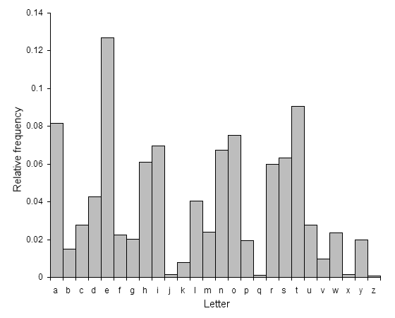
Breaking Substitution Ciphers
One method that can be used to break these ciphers is frequency analysis
The most common letters in English are E, A, and T
Using trial and error it is possible to decode messages by replacing the most common letters with E, A, or T

Slide 21
A New Method: Bifid Cipher
The main problem with substitution ciphers is that the order of the letters does not change
More advanced ciphers can involve rearranging letters to try to avoid this problem

Slide 22
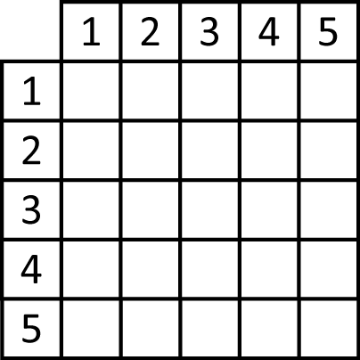
A New Method: Bifid Cipher
The bifid cipher uses a device called a Polybius square
We will fill the alphabet into this grid
Notice there are only 25 spaces; we will replace all the J’s in our message with I

Slide 23
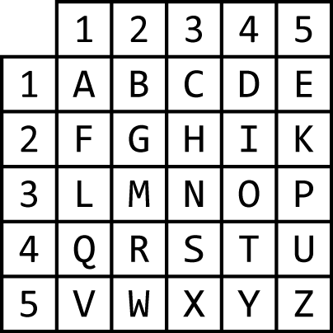
A New Method: Bifid Cipher
We could fill in the alphabet in order…

Slide 24
A New Method: Bifid Cipher
…or we can create a square based on a keyword
We start by filling in the letters of the keyword across the rows, leaving out duplicates
Let’s use the keyword “CONFIDENTIAL”

Slide 25
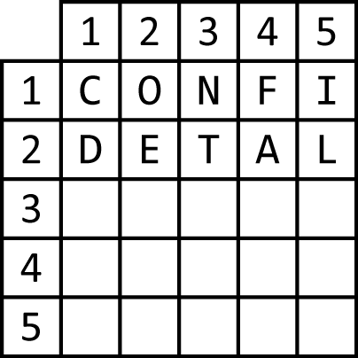
A New Method: Bifid Cipher
Fill in the letters of the keyword “CONFIDENTIAL”

Slide 26
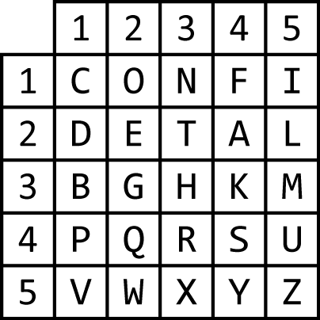
A New Method: Bifid Cipher
Fill in the letters of the keyword “CONFIDENTIAL”
Then fill in the rest of the alphabet, again going across the rows and never duplicating a letter

Slide 27
A New Method: Bifid Cipher
Now let’s use this square to encode a short message: “RETREAT”
As we will see, the bifid cipher requires messages to have an even number of letters
Since “RETREAT” has 7 letters, we will add a dummy character to the end

Slide 28
A New Method: Bifid Cipher
Now we “look up” each letter of our message in the table
Letter | R | E | T | R | E | A | T | X
Row
Column

Slide 29
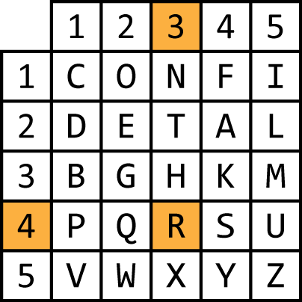
A New Method: Bifid Cipher
Now we “look up” each letter of our message in the table
Letter | R | E | T | R | E | A | T | X
Row | 4
Column | 3

Slide 30
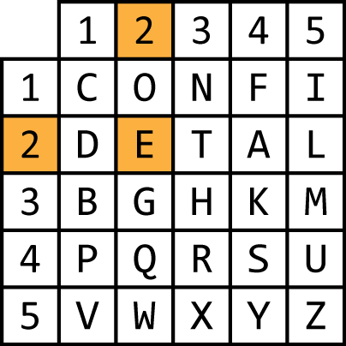
A New Method: Bifid Cipher
Now we “look up” each letter of our message in the table
Letter | R | E | T | R | E | A | T | X
Row | 4 | 2
Column | 3 | 2

Slide 31
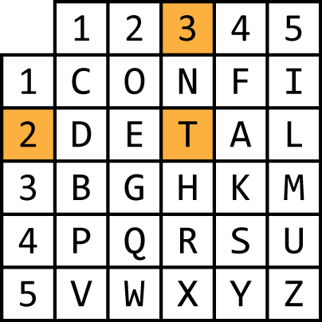
A New Method: Bifid Cipher
Now we “look up” each letter of our message in the table
Letter | R | E | T | R | E | A | T | X
Row | 4 | 2 | 2
Column | 3 | 2 | 3

Slide 32
A New Method: Bifid Cipher
Now we “look up” each letter of our message in the table
Letter | R | E | T | R | E | A | T | X
Row | 4 | 2 | 2 | 4
Column | 3 | 2 | 3 | 3

Slide 33
A New Method: Bifid Cipher
Now we “look up” each letter of our message in the table
Letter | R | E | T | R | E | A | T | X
Row | 4 | 2 | 2 | 4 | 2
Column | 3 | 2 | 3 | 3 | 2

Slide 34
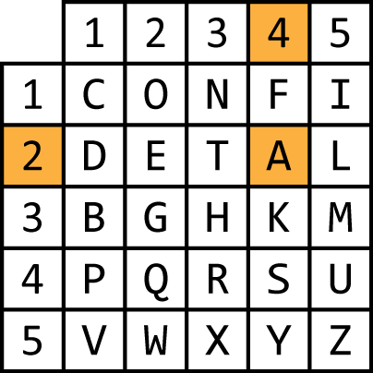
A New Method: Bifid Cipher
Now we “look up” each letter of our message in the table
Letter | R | E | T | R | E | A | T | X
Row | 4 | 2 | 2 | 4 | 2 | 2
Column | 3 | 2 | 3 | 3 | 2 | 4

Slide 35
A New Method: Bifid Cipher
Now we “look up” each letter of our message in the table
Letter | R | E | T | R | E | A | T | X
Row | 4 | 2 | 2 | 4 | 2 | 2 | 2
Column | 3 | 2 | 3 | 3 | 2 | 4 | 3

Slide 36
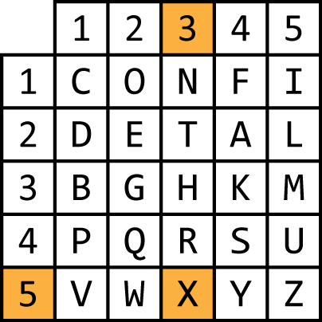
A New Method: Bifid Cipher
Now we “look up” each letter of our message in the table
Letter | R | E | T | R | E | A | T | X
Row | 4 | 2 | 2 | 4 | 2 | 2 | 2 | 5
Column | 3 | 2 | 3 | 3 | 2 | 4 | 3 | 3

Slide 37
A New Method: Bifid Cipher
Next, we group the numbers in pairs reading across from left to right
Letter | R | E | T | R | E | A | T | X
Row | 4 | 2 | 2 | 4 | 2 | 2 | 2 | 5
Column | 3 | 2 | 3 | 3 | 2 | 4 | 3 | 3

Slide 38
A New Method: Bifid Cipher
Next, we group the numbers in pairs reading across from left to right
4 | 2 | 2 | 4 | 2 | 2 | 2 | 5
3 | 2 | 3 | 3 | 2 | 4 | 3 | 3

Slide 39
A New Method: Bifid Cipher
Next, we group the numbers in pairs reading across from left to right
4 | 2 | 2 | 4 | 2 | 2 | 2 | 5
3 | 2 | 3 | 3 | 2 | 4 | 3 | 3

Slide 40
A New Method: Bifid Cipher
Next, we group the numbers in pairs reading across from left to right
4 | 2 | 2 | 4 | 2 | 2 | 2 | 5 | 3 | 2 | 3 | 3 | 2 | 4 | 3 | 3

Slide 41
A New Method: Bifid Cipher
Now we look up these new pairs of numbers in our Polybius square
4 | 2 | 2 | 4 | 2 | 2 | 2 | 5 | 3 | 2 | 3 | 3 | 2 | 4 | 3 | 3

Slide 42
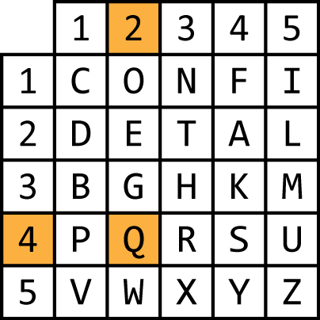
A New Method: Bifid Cipher
Now we look up these new pairs of numbers in our Polybius square
4 | 2 | 2 | 4 | 2 | 2 | 2 | 5 | 3 | 2 | 3 | 3 | 2 | 4 | 3 | 3
Q

Slide 43
A New Method: Bifid Cipher
Now we look up these new pairs of numbers in our Polybius square
4 | 2 | 2 | 4 | 2 | 2 | 2 | 5 | 3 | 2 | 3 | 3 | 2 | 4 | 3 | 3
Q |  | A

Slide 44
A New Method: Bifid Cipher
Now we look up these new pairs of numbers in our Polybius square
4 | 2 | 2 | 4 | 2 | 2 | 2 | 5 | 3 | 2 | 3 | 3 | 2 | 4 | 3 | 3
Q |  | A |  | E

Slide 45
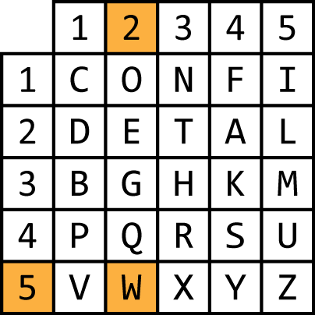
A New Method: Bifid Cipher
Now we look up these new pairs of numbers in our Polybius square
4 | 2 | 2 | 4 | 2 | 2 | 2 | 5 | 3 | 2 | 3 | 3 | 2 | 4 | 3 | 3
Q |  | A |  | E |  | W

Slide 46
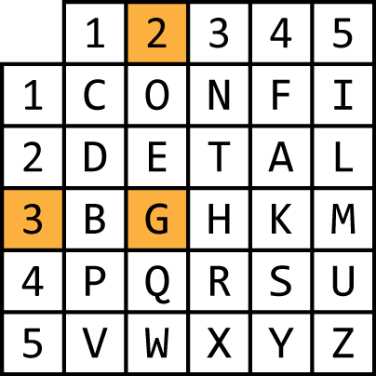
A New Method: Bifid Cipher
Now we look up these new pairs of numbers in our Polybius square
4 | 2 | 2 | 4 | 2 | 2 | 2 | 5 | 3 | 2 | 3 | 3 | 2 | 4 | 3 | 3
Q |  | A |  | E |  | W |  | G

Slide 47
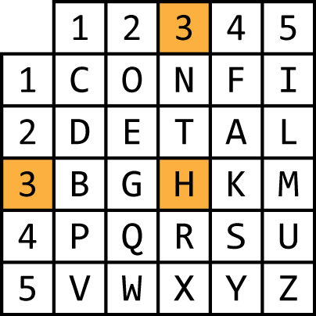
A New Method: Bifid Cipher
Now we look up these new pairs of numbers in our Polybius square
4 | 2 | 2 | 4 | 2 | 2 | 2 | 5 | 3 | 2 | 3 | 3 | 2 | 4 | 3 | 3
Q |  | A |  | E |  | W |  | G |  | H

Slide 48
A New Method: Bifid Cipher
Now we look up these new pairs of numbers in our Polybius square
4 | 2 | 2 | 4 | 2 | 2 | 2 | 5 | 3 | 2 | 3 | 3 | 2 | 4 | 3 | 3
Q |  | A |  | E |  | W |  | G |  | H |  | A

Slide 49
A New Method: Bifid Cipher
Now we look up these new pairs of numbers in our Polybius square
4 | 2 | 2 | 4 | 2 | 2 | 2 | 5 | 3 | 2 | 3 | 3 | 2 | 4 | 3 | 3
Q |  | A |  | E |  | W |  | G |  | H |  | A |  | H

Slide 50
A New Method: Bifid Cipher
Now we look up these new pairs of numbers in our Polybius square
So our encoded message is “QAEWGHAH”
4 | 2 | 2 | 4 | 2 | 2 | 2 | 5 | 3 | 2 | 3 | 3 | 2 | 4 | 3 | 3
Q |  | A |  | E |  | W |  | G |  | H |  | A |  | H

Slide 51
A New Method: Bifid Cipher
To decode a message, simply reverse this process
Look up each letter in the Polybius square, writing down the row, then the column (but write the numbers from left to right)
Then split the message in half and put the second half below the first half
Finally, decode the message by lookup up each letter in the Polybius square

Slide 52
Decoding Bifid
The message “SAWA BTBK KSTV LAAA” was encoded with the bifid cipher using a Polybius square based on the keyword “Schwarzenegger”
Decode the message

Slide 53
Decoding Bifid
Message: SAWA BTBK KSTV LAAA
Keyword: Schwarzenegger
First we check to make sure that the message has an even number of letters, which it does (16)
Then we create our Polybius square

Slide 54
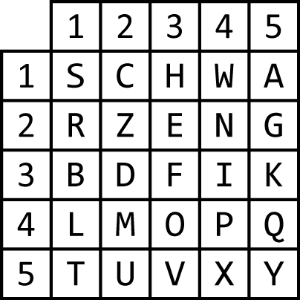
Decoding Bifid
S | A | W | A | B | T | B | K | K | S | T | V | L | A | A | A
11 | 15 | 14 | 15 | 31 | 51 | 31 | 35 | 35 | 11 | 51 | 53 | 41 | 15 | 15 | 15

Slide 55
Decoding Bifid
S | A | W | A | B | T | B | K | K | S | T | V | L | A | A | A
11 | 15 | 14 | 15 | 31 | 51 | 31 | 35 | 35 | 11 | 51 | 53 | 41 | 15 | 15 | 15

Slide 56
Decoding Bifid
11 | 15 | 14 | 15 | 31 | 51 | 31 | 35 | 35 | 11 | 51 | 53 | 41 | 15 | 15 | 15

Slide 57
Decoding Bifid
11 | 15 | 14 | 15 | 31 | 51 | 31 | 35
35 | 11 | 51 | 53 | 41 | 15 | 15 | 15

Slide 58
Decoding Bifid
1 | 1 | 1 | 5 | 1 | 4 | 1 | 5 | 3 | 1 | 5 | 1 | 3 | 1 | 3 | 5
3 | 5 | 1 | 1 | 5 | 1 | 5 | 3 | 4 | 1 | 1 | 5 | 1 | 5 | 1 | 5

Slide 59
Decoding Bifid
1 | 1 | 1 | 5 | 1 | 4 | 1 | 5 | 3 | 1 | 5 | 1 | 3 | 1 | 3 | 5
3 | 5 | 1 | 1 | 5 | 1 | 5 | 3 | 4 | 1 | 1 | 5 | 1 | 5 | 1 | 5
H | A | S | T | A | L | A | V | I | S | T | A | B | A | B | Y

